Slide 1
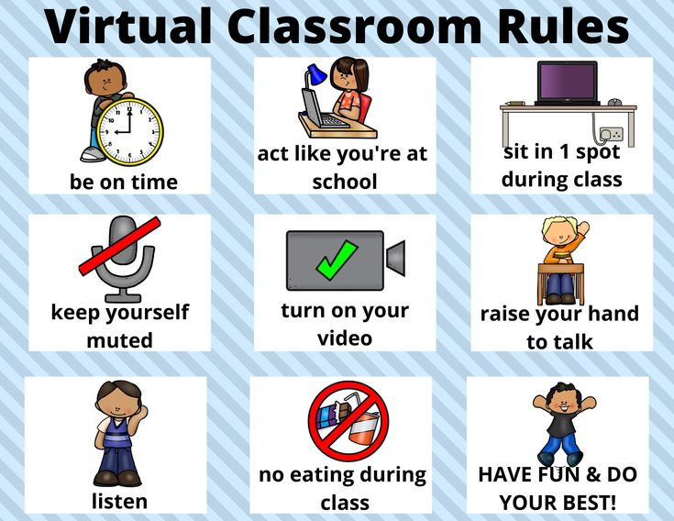

Slide 2
Listen,
point and repeat
SEASONS

Slide 3
spring

Slide 4
summer

Slide 5
fall

Slide 6
winter

Slide 7
Student book page 12

Slide 10
b
b
a
a
a

Slide 11
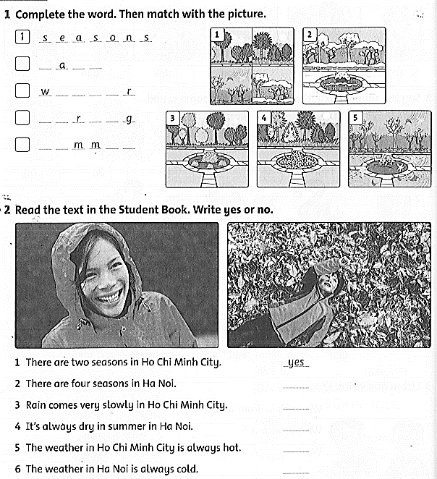
Workbook time!!!
Workbook page 12

Slide 12
f l l
5
i n t e
2
s p i n
3
s u e r
4

Slide 13
yes
no
no
yes
no

